Slide 1
29.02.2024
No.15 3D-X
Product training

Slide 2
No.15 3D-X
Product training
Product philosophy
Technology
Key arguments
Learn all about the main selling points here. Get to know the story behind the product No.15 3D-X and see why this product is so important for a well-equipped kitchen. Find out how much benefit the No.15 3D-X offers. See what planning possibilities arise in a modern kitchen with No.15 3D-X.
This chapter offers more detailed information on technical specifications such as assembled dimensions, permissible loads and technical features. The installation step demonstrates the simple assembly concept. In addition, you will see which assembly aids are available for No. 15 3D-X.
Here you will find the most important features and key arguments about the product summarized and at a glance.

Slide 3
Product philosophy

Slide 4
Product philosophy
01
02
03
the Need
the Solution
the Story
04
05
the Benefit
the Planning

Slide 5
01
01
the Need

Slide 6
Does the topic of order and overview take place in your planning?

Slide 7
How do you plan access to cooking utensils at the cooking area?

Slide 8
Where do you plan to store towels?

Slide 9
How important is the optimal use of storage space in small kitchens to you?

Slide 10
How important is freedom of complaint to you?

Slide 11
How important are short processing times to you?

Slide 12
02
02
the Solution

Slide 13
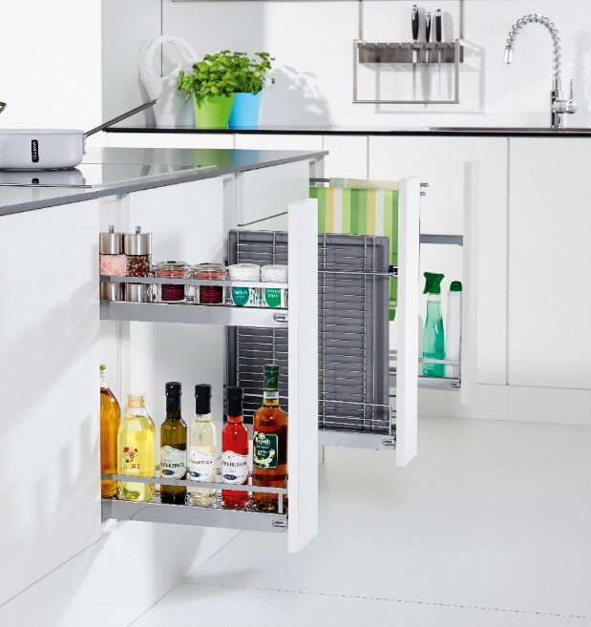
No.15 3D-X
The Solution
Whether 2-tier, 3-tier, towel or baking tray pull-out, the No. 15 3D-X makes perfect use of even the smallest niches.

Slide 14
03
03
the Story

Slide 15
Every centimeter counts – No.15 3D-X makes the gap into space!
the Story
Kitchen planning is almost complete, but there is a gap in the corner. What now? Install a provisional device or leave the gap completely unused?
The No.15 3D-X fills gaps easily and allows you to make storage space flexible and optimally usable during planning. With the No.15 3D-X you have all the freedom in kitchen planning.
Thanks to its attractive “column design”, No.15 3D-X can be used to set additional visual accents in the kitchen front.

Slide 16
No.15 3D-X – a specialist
the Story
Do the dishes quickly, but where to put the wet towel? Hang over the stove or just leave it in the sink. Neither are optimal solutions.
This is remedied by the No.15 3D-X. Simply hang the damp towels on the towel holder and they will have disappeared from view and can dry until you can get them out again the next time you use them.
Fast and easy.

Slide 17
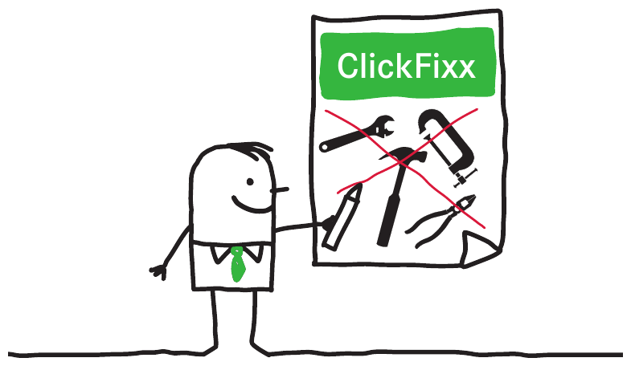
Installation made easy
the Story
The old fitting is getting old and needs to be replaced or you want to replace simple shelves with a comfortable fitting. But is it that easy?
No.15 3D-X has “Clickfixx” so the fitting can be easily mounted on the pull-out rails and the front. With the 3D real-time front setting, the front image is perfectly set within a few seconds.
Simple and convenient – without tools and mechanics!

Slide 18
04
04
the Benefit

Slide 19
Optimal width utilization
the Benefit
No.15 3D-X offers the optimal width utilization in its class and allows you to store 1.5L PET bottles yourself.

Slide 20
For small kitchens
the Benefit
Especially in small kitchens, No.15 3D-X is an excellent addition due to the optimal storage space in small niches.

Slide 21
Unusual line dimensions
the Benefit
No.15 3D-X offers functional and visually appealing solutions for unusual line dimensions or demanding architectures.

Slide 22
Hygienic
the Benefit
Thanks to its sheet metal shelves, No.15 3D-X is easy and quick to clean and offers you a hygienic storage option.

Slide 23
Perfect access…
the Benefit
…to the baking tray, which is often difficult to access.

Slide 24
Tidy
the Benefit
Also hides wet towels and ensures a tidy kitchen.

Slide 25
Both sides access
the Benefit
Due to its symmetrical structure, the No.15 3D-X in the 2-tier version can be accessed on both sides and can be freely planned in the kitchen..

Slide 26
Faster assembly
the Benefit
ClickFixx for runners and front connect the individual components quickly and easily. This enables unrestricted access to the work area and thus faster assembly.

Slide 27
Easier adjustment
the Benefit
With the tool-free 3D front adjustment, the fitter can concentrate fully on the joint pattern, since the large setting elements can be reached without a direct view.
Result: The front is set perfectly in seconds.

Slide 28
Product quality
the Benefit
The extraordinary product quality of No.15 3D-X is designed for over 80,000 opening and closing cycles and thus easily survives an entire kitchen life.

Slide 29
05
05
the Planning

Slide 30
No.15 3D-X
the Planning
No.15 3D-X

Slide 31
No.15 3D-X
the Planning
No.15 3D-X
No.15 3D-X

Slide 32
No.15 3D-X
the Planning
No.15 3D-X
No.15 3D-X

Slide 33
Technology

Slide 34
Technology
01
02
03
the Technical specifications
the Installation
the Mounting aids

Slide 35
01
01
the Technical specifications

Slide 36
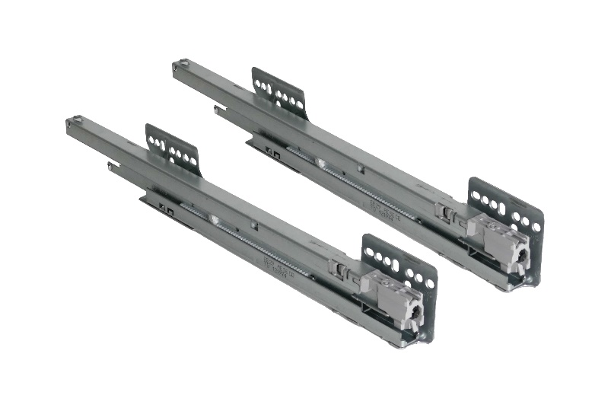
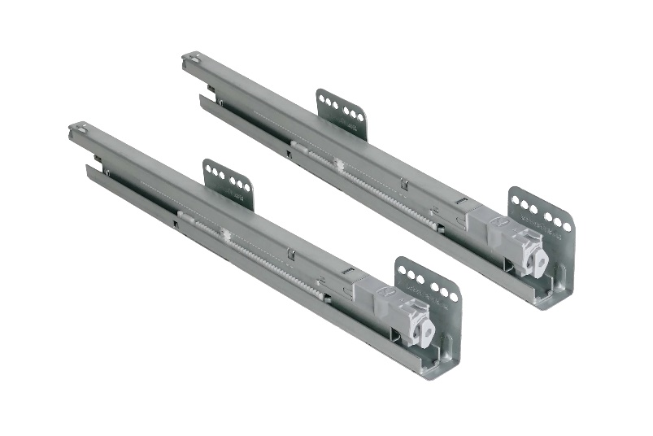
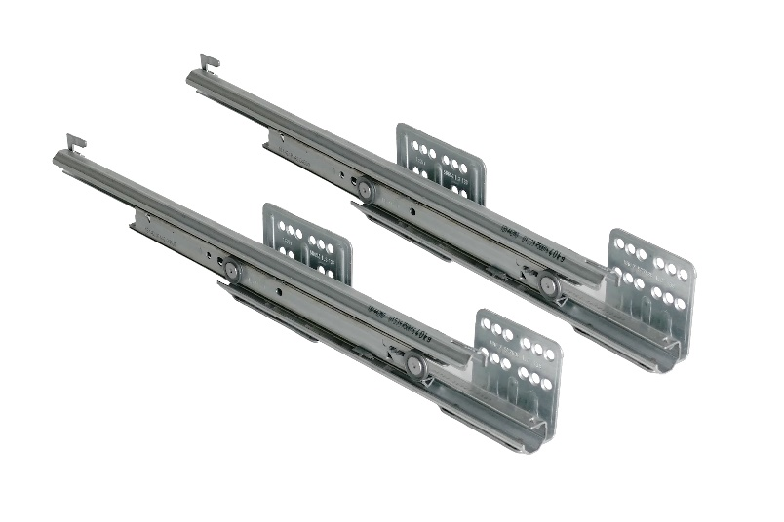
Rail types
the Technical specifications
The No.15 3D-X can be ordered compatible for different rail types. We list the different types of rails here.
.
GRASS NovaPro 465 NL
Specially adapted to the requirements of the No. 15 3D-X, the modern GRASS NovaPro in a nominal length of 465 mm generates a high level of running and closing comfort with good lateral stability and particularly low pull-out forces.
Kesseböhmer Sx
The side-mounted Kesseböhmer Sx offers you high running and closing comfort with good lateral stability thanks to the latest technology.
Hettich Actro
With the adaptation to the Hettich Actro, we also offer our customers the option of using their own in-house rails.

Slide 37
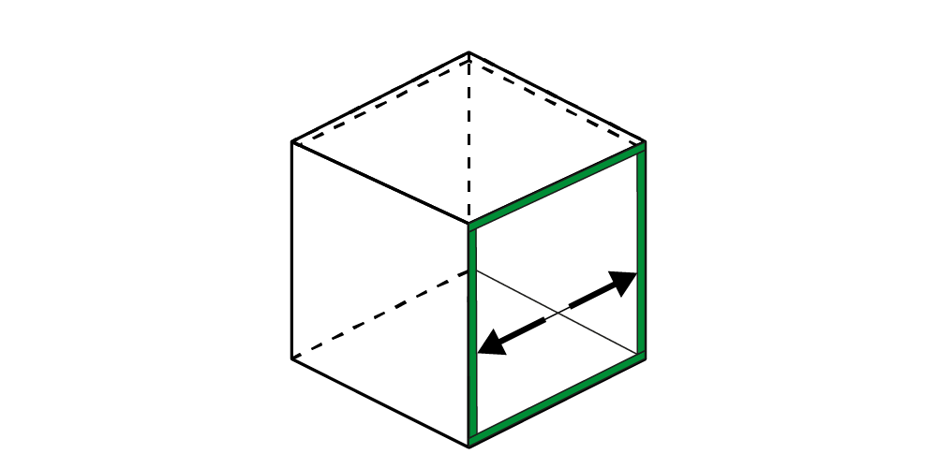
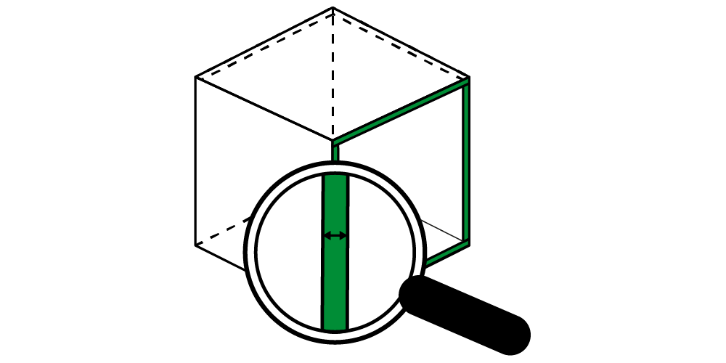
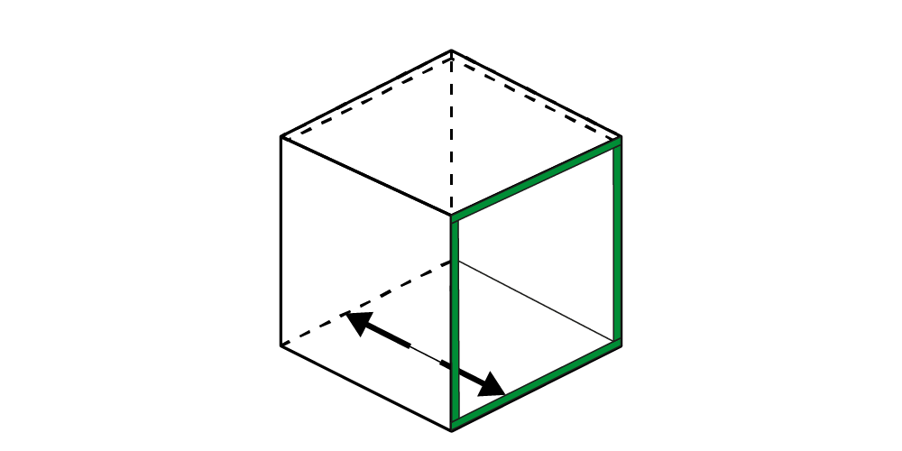
Installation dimensions 2-tier and backing tray GRASS NovaPro 465 NL
the Technical specifications
≥ 112 mm
16 – 19 mm
≥ 489 mm
≥ 540 mm
News 2024:
Use of the modern successor to the XP rail with better running properties.

Slide 38
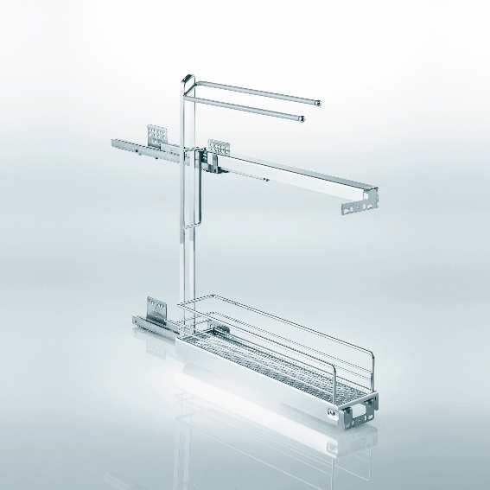
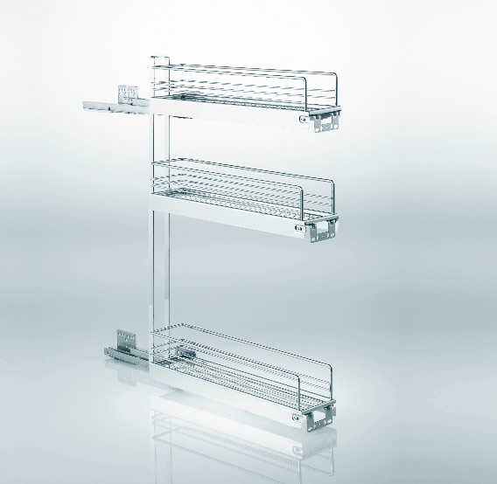
Differences to other variants GRASS NovaPro 465 NL
the Technical specifications
≥ 590 mm
≥ 760 mm
Towell
3-tier

Slide 39
Installation dimensions 2-tier and backing tray Kesseböhmer Sx
the Technical specifications
≥ 112 mm
16 – 19 mm
≥ 485 mm
≥ 550 mm
News Version 2024:
Compatible with many Systen32 standard drilling patterns by changing the body angle. Compatible with 19 mm side panel thicknesses.

Slide 40
Differences to other variants Kesseboehmer Sx
the Technical specifications
≥ 600 mm
Towel
3-storey not available, as the clear installation dimension is too high.

Slide 41
Installation dimensions 2-tier and backing tray Hettich Actro
the Technical specifications
≥ 112 mm
16 – 19 mm
≥ 510 mm
≥ 553 mm

Slide 42
Differences to other variants Hettich Actro
the Technical specifications
≥ 603 mm
Towell
3-storey not available, as the clear installation dimension is too high.

Slide 43
Load capacity and system weight
the Technical specifications
Load capacity 2-tier base cabinet pull-out:
Load capacity per tray: 6 kg
System weight: 12 kg
Load capacity of towel rail and baking tray pull-out:
Load capacity per tray: 6 kg
System weight: 10 kg

Slide 44
SoftSTOPPplus – in all runners
the Technical specifications
The No.15 closes comfortably due to the damped self-close of the pull-out rail.
GRASS NovaPro 465 NL
Kesseböhmer Sx

Slide 45
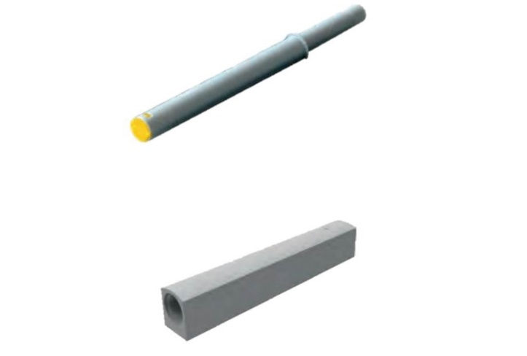
Handleless opening – push-to-open
the Technical specifications
Can be retrofitted to the existing rails.
No separate fitting is necessary.
Push-to-open (PTO) Typ II (yellow)

Slide 46
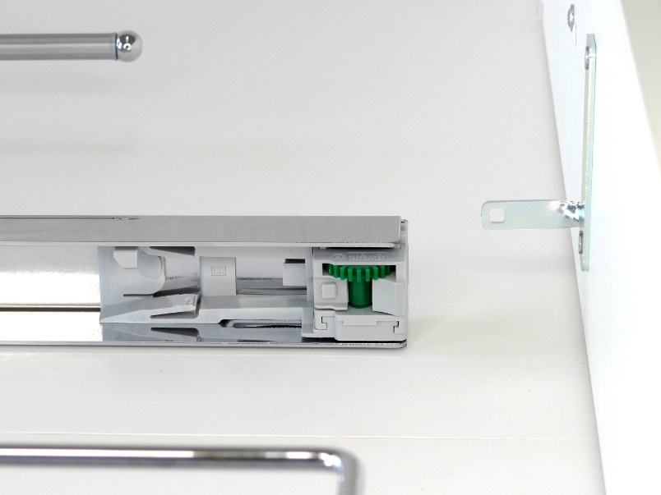
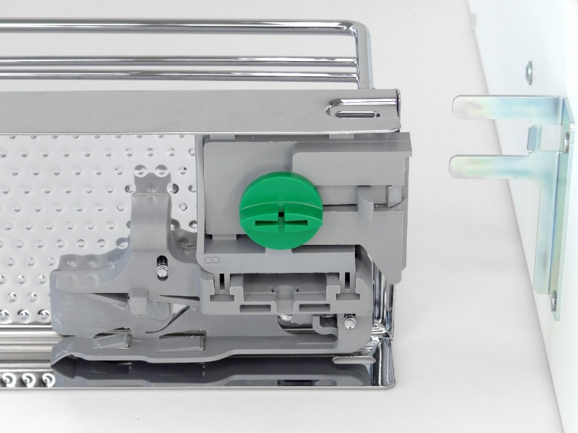
ClickFixx – tool-free assembly
the Technical specifications
The front is connected to the fitting by snapping the front bracket into the adjustment mechanism.
The fitting is connected to the pull-out rails by snapping on the adjustment mechanism.
The upper front connector differs depending on the variant of the No.15. The lower front connector is identical in the variants.
Front bracket above No.15 Towel holder and baking tray pull-out
Front bracket No.15
Front bracket
Front bracket
Adjustment mechanics
Adjustment mechanics
Front bracket for:
Towel holder and baking tray pull-out at the top
Front bracket for:
Towel holder and baking tray pull-out at the bottom
2-tier base cabinet pull-out top + bottom

Slide 47
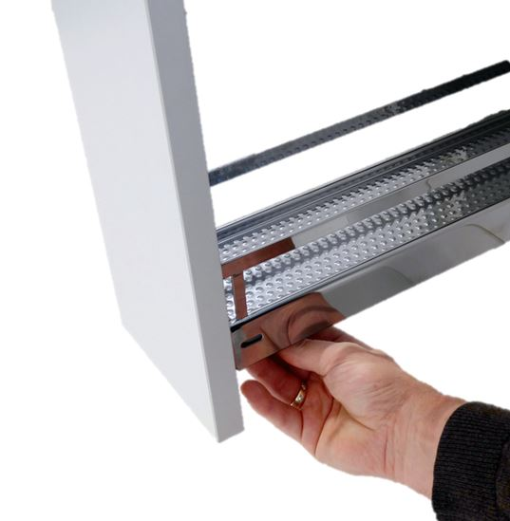
3D-X tool-free adjustment
the Technical specifications
The 3-dimensional setting of the front is carried out without tools using setting wheels in a striking green.
The size of the adjusting wheels allows the front to be “blind” without adjusting the line of sight.

Slide 48
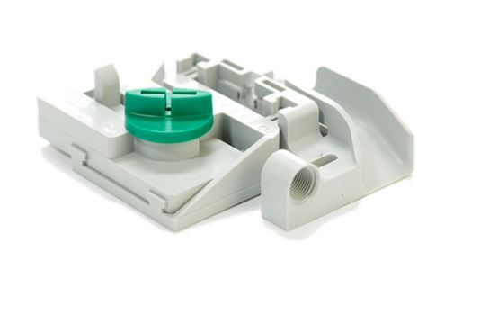
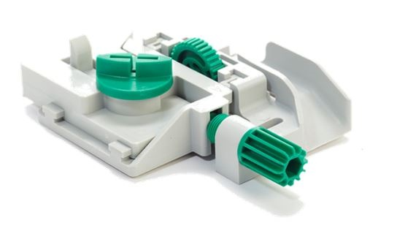
3D-X – No.15 2-tier
the Technical specifications
No.15 3D-X – Upper adjustment dimensions
No.15 3D-X – Lower adjustment dimensions
Adjusting screw for height adjustment
Adjusting screw for lower side adjustment
Adjusting screw for upper side adjustment
Adjusting screw for tilt adjustment
Side adjustment +/- 2.5mm
Height: floating
Height adjustment +/- 2.5mm
Side adjustment +/- 2.5mm
Tilt adjustment +/- 3mm

Slide 49
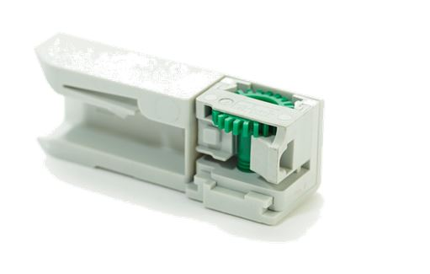
3D-X – No.15 2-tier
the Technical specifications
No.15 3D-X – adjustment dimensions
No.15 3D-X – adjustment dimensions
Adjusting screw for height adjustment
Adjusting screw for lower side adjustment
Adjusting screw for upper side adjustment
Adjusting screw for tilt adjustment
Side adjustment +/- 2.5mm
Height: floating
Height adjustment +/- 2.5mm
Side adjustment +/- 2.5mm
Tilt adjustment +/- 3mm

Slide 50
02
02
the Installation

Slide 51
Preparation
the Installation
Prior to assembly, attention must be paid to the following::
The cabinet must be aligned.
The cabinet must be secured to the wall.

Slide 52
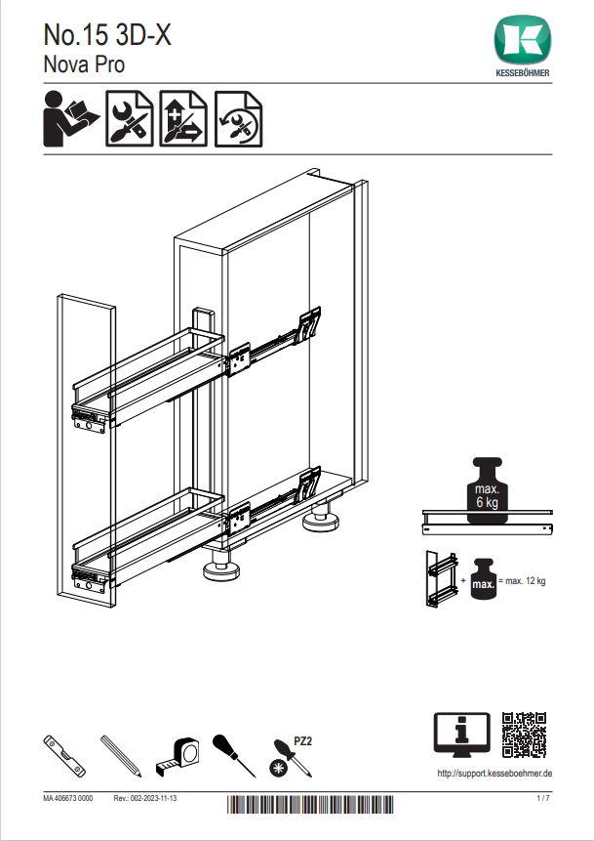
Assembly in 3 simple steps
the Installation
Installation of the pull-out rails
Installation of the fitting
Adding the front
The detailed information can be found in the assembly instructions. The assembly instructions for all fitting variants can be found in the document directory.

Slide 53
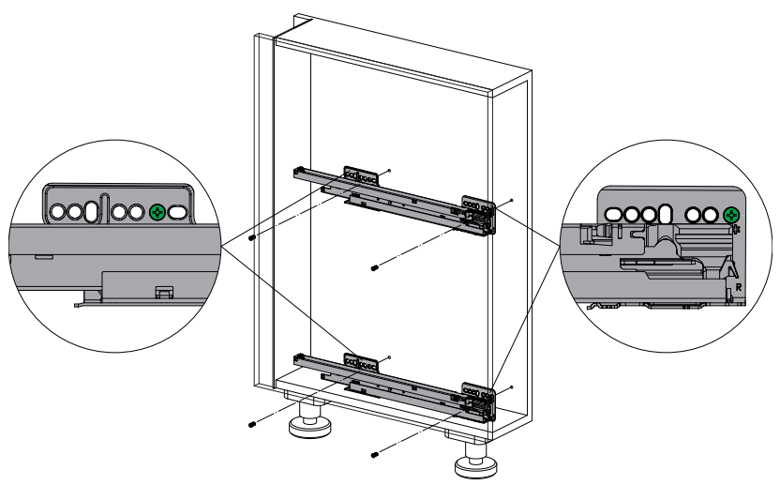
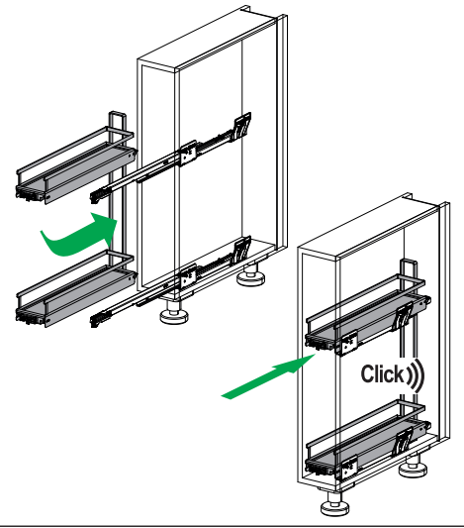
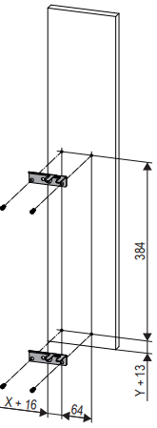
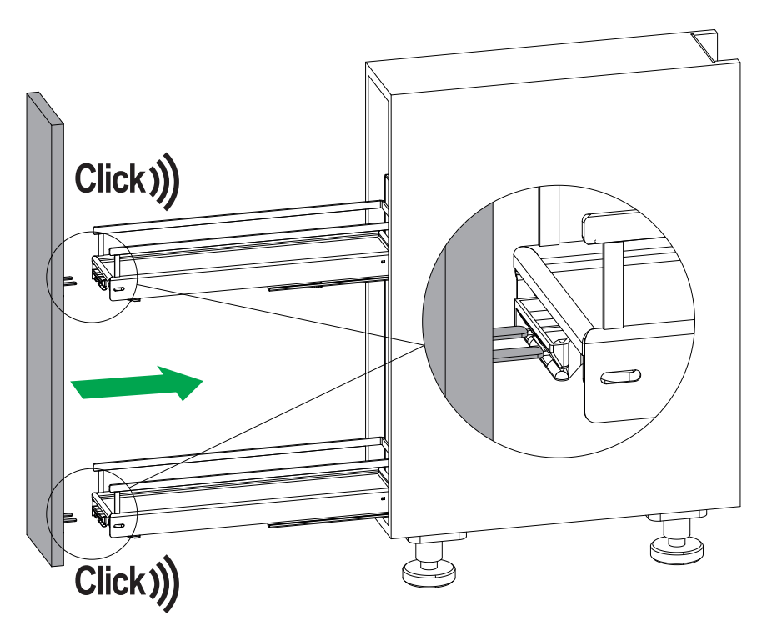
Assembly in 3 simple steps
the Installation
1.
2.
3.
First mount the pull-out rails on the cabinet side.
With the Clickfixx system, the fitting can simply be snapped onto the pull-out rails.
First mount the front bracket, then the front can simply be snapped onto the fitting using the Clickfixx system.

Slide 54
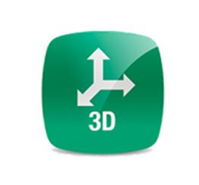
Adjustment
the Installation
Only the front has to be adjusted!
The 3D-X technology makes the adjustment quick and easy using the green setting wheels!
The adjustment can also be done “blind”!

Slide 55
03
03
the Mounting aids

Slide 56
Template
the Mounting aids
Marking templates can be added to the packaging on request and in sufficient quantities, e.g. for DIY stores.
However, these must be developed for the new rails from 2024.
Old templates cannot be used.

Slide 57
Key arguments

Slide 58
No.15 3D-X
Key arguments
CLOSES PLANNING GAPS
QUICK AND EASY INSTALLATION
QUICK AND EASY ADJUSTMENT
The No. 15 3D-X makes the gap into space and enables functional solutions for unusual line dimensions.
Front and runner ClickFixx enable fast and error-free installation.
Thanks to the tool-free and blind-operated front adjustment, the front can be set up quickly by the end customer.
OPTIMAL WIDE USE
FIRM PLACE FOR THE TOWEL
MAXIMUM COMFORT
The No. 15 3D-X has the best width utilization in its class and can even hold 1.5L PET bottles.
The towels in use disappear from view and still remain in direct access.
In addition to the damped closing full extension slides, the No. 15 3D-X can even be opened without a handle.

